Slide 1
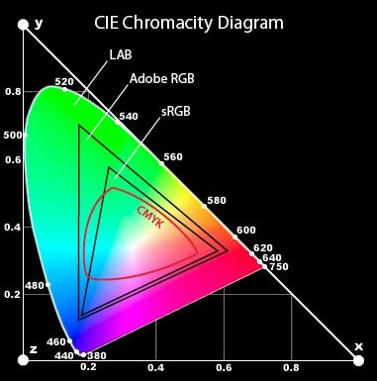
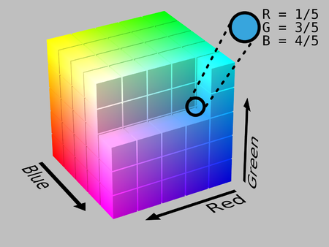

Rgb
Because the human eye only has color sensitive receptors for red, green and blue, it is theoretically possible to decompose every visible color into combinations of these three “primary colors.” Color monitors, for instance, can display millions of colors simply by mixing different intensities of red, green and blue. It is most common to place the range of intensity for each color on a scale from 0 to 255 (one byte). The range of intensity is also known as the “color depth”.
The possibilities for mixing the three primary colors together can be represented as a three dimensional coordinate plane with the values for R (red), G (green) and B (blue) on each axis. This coordinate plane yields a cube called the RGB color space:

Slide 2
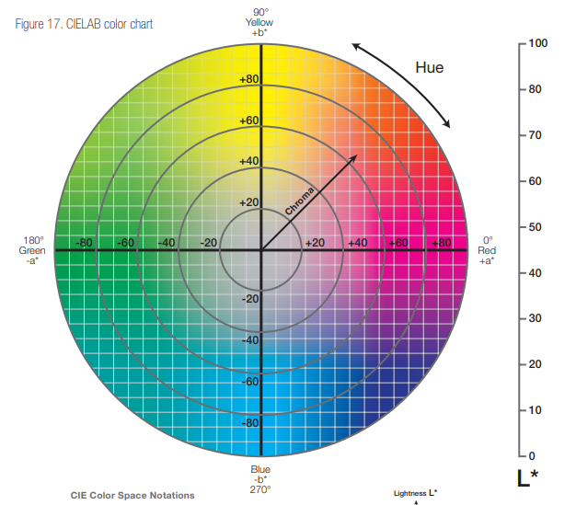
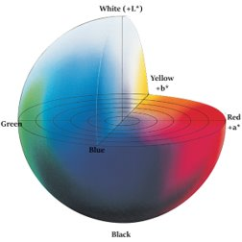
Lab​
Cie-L*ab is defined by lightness and the color-opponent dimensions a and b, which are based on the compressed XYZ color space coordinates. Lab is particularly notable for it's use in delta-e calculations.​
The color system represents quantitative relationship of colors on three axes: L* value indicates lightness, and a* and b* are chromaticity coordinates. On the color space diagram, L* is represented on a vertical axis with values from 0 (black) to 100 (white). The a* value indicates red-green component of a color, where þa* (positive) and Àa* (negative) indicate red and green values, respectively. The yellow and blue components are represented on the b* axis as þb* (positive) and Àb* (negative) values, respectively. At the center of the plane is neutral or achromatic. The distance from the central axis represents the chroma (C*), or saturation of the color. The angle on the chromaticity axes represents the hue (h o ).
The L*, a*, and b* values can be transcribed to dermatological parameters.

Slide 3
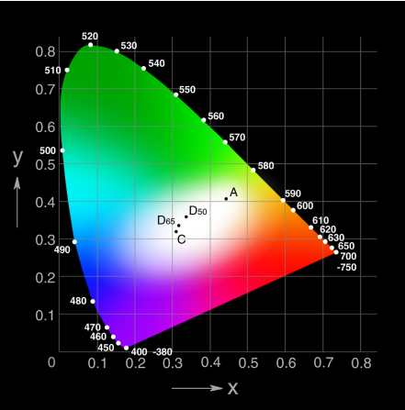
Conversion process
RGB It should also be noted that due to Lab nature srgb->lab conversion depends on an additional parameter: whitepoint, eg:​
• Photoshop uses a white point called D50 (which is a standard for icc)​
• OpenCV and skimage use D65 (which is a standard for srgb).​
• default Matlab implementation uses D50 (it is capable of using others),​to LAB​
You can tell which whitepoint you're dealing with by converting RGB (0,0,255) to Lab:​
• D50 would give you (30, 68, -112)​
• D55 (30, 73, -110)​
• D65 (32, 79, -108)​
The numbers after 'D' correspond to (internally) used color
temperature of white point: D50 = 5003 K (yellowish),
D65 = 6504 K (blueish)​

Slide 4
RGB to XYZ
A companded RGB color [RGB], whose components are in the nominal range [0, 1], is converted to XYZ in two steps.
1. Inverse Companding
First, the companded RGB channels (denoted with upper case (R,G,B)(R,G,B), or generically VV) are made linear with respect to energy (denoted with lower case (r,g,b)(r,g,b), or generically vv).
The same operation is performed on all three channels, but the operation depends on the companding function associated with the RGB color system.
Inverse Gamma Companding
Inverse sRGB Companding

Slide 5
Inverse L* Companding
2. Linear RGB to XYZ
The transformation matrix [M][M] is calculated from the RGB reference primaries as discussed here.
The gamma values for many common RGB color spaces may be found here.
Your input RGB values may need to be scaled before using the above. For example, if your values are in the range [0, 255], you must first divide each by 255.0.
The output XYZ values are in the nominal range [0.0, 1.0].
The XYZ values will be relative to the same reference white as the RGB system. If you want XYZ relative to a different reference white, you must apply a chromatic adaptation transform to the XYZ color to convert it from the reference white of the RGB system to the desired reference white.
Sometimes the more complicated special case of sRGB shown above is replaced by a "simplified" version using a straight gamma function with γ=2.2γ=2.2

Slide 6
XYZ to Lab
This conversion requires a reference white (Xr,Yr,Zr)(Xr,Yr,Zr).
where

Slide 7
Implementation Notes:
For an explanation of and click here

Slide 8
Advantages of converting RGB color space to CIELab:
Main advantage on RGB is by having 1 channel dedicated to the Luminosity of the Image and 2 others dedicated to the color information. This means if you need to process only Luminosity / Color you can do that using LAB without having any effect on Color / Luminosity.​
The purpose of this CIELab color space is to enhance the color images better than RGB space, where it can represent an infinite number of ranges of chromatic than other color space models. Unlike most of the other objective color measuring methods, CIELab can provide highly accurate noncontact color readings, thus avoiding undesirable edge-loss errors characteristic of contact-type color measuring instruments.​
RGB is how displays perceive the world. CMYK is how printers perceive the world. Lab is how humans perceive the world.​
The big disadvantages of Lab are:
It doesn’t work well for strong contrast (> 7 EV), and especially outside the range [1:100] Cd/m²,
It is not linear in hue, i.e. if one fixes a pixel’s a and b chromaticity components and changes only its brightness L, the same hue would be expected at a different brightness (this was the design purpose of the Lab space), however there is a slight shift in the hue, more or less marked depending on the original color of the pixel.

Slide 9
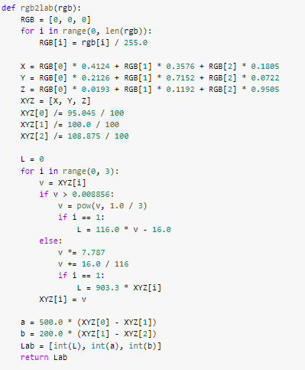
Rgb to Lab

Slide 10
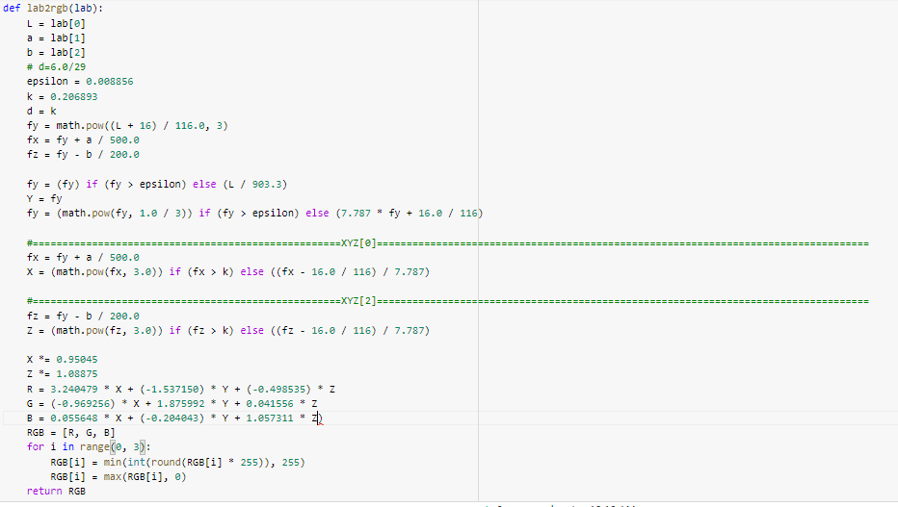
Lab to Rgb

Slide 11
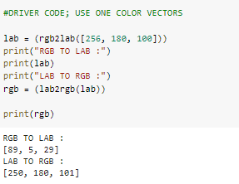
Driver code

